Slide 1

Computer Graphics and Image Processing
Illumination and Shading III:
Lights and Shadows

Slide 2
Today’s Outline
Lights in OpenGL
Materials in OpenGL
Projected Shadows
Shadow Maps
Light Maps

Slide 3
OpenGL Lights
In OpenGL, illumination and shading algorithms are already implemented
We define the variables for the equations and let OpenGL do the work
Light intensities
Surface properties
Geometry (normals, light/camera positions)

Slide 4
OpenGL Lights
Lighting is a fixed step, but we can configure how it works
OpenGL uses a set of fixed light defines
(exact number is implementation specific)
We have to enable the light(s) we choose to use
GL_LIGHT1, GL_LIGHT2,
etc
glEnable(GL_LIGHT1); //the light
glEnable(GL_LIGHTING); //lighting in general

Slide 5
OpenGL Lights
We have to configure each property on the light
Configuring location:
glLightfv(Glenum light, //the light
GLenum pname, //the property
const GLfloat *params); //the value
Glfloat[] lightPosition = {10.0f, 10.0f, 10.0f, 1.0f};
glLightfv(GL_LIGHT1, //the light
GL_POSITION, //the property
lightPosition); //the value

Slide 6
OpenGL Lights
Configuring intensities:
Glfloat[] ambientLight = {0.3f, 0.3f, 0.3f, 1.0f};
glLightfv(GL_LIGHT1, //the light
GL_AMBIENT, //the property
ambientLight); //the value
Glfloat[] diffuseLight = {1.0f, 1.0f, 1.0f, 1.0f};
glLightfv(GL_LIGHT1, //the light
GL_DIFFUSE, //the property
diffuseLight); //the value
Glfloat[] specularLight = {1.0f, 1.0f, 1.0f, 1.0f};
glLightfv(GL_LIGHT1, //the light
GL_SPECULAR, //the property
specularLight); //the value

Slide 7
OpenGL Materials
In addition to setting up scene lights, we have to define surface material properties
Materials work like colours – we set them and they apply until we set a new one
We set material properties in the same way as lights:
glMaterial(GLenum face, //the side of the polygon
GLenum pname, //the property
const GLfloat *params); //the value

Slide 8
OpenGL Materials
Configuring material properties:
Glfloat[] mat_ambient = {0.5f, 0.5f, 0.5f, 1.0f};
glMaterialfv(GL_FRONT, //front faces
GL_AMBIENT, //the property
mat_ambient); //the value
Glfloat shininess= 80.0f
glMaterialfv(GL_FRONT, //front faces
GL_SHININESS, //the property
shininess); //the value

Slide 9
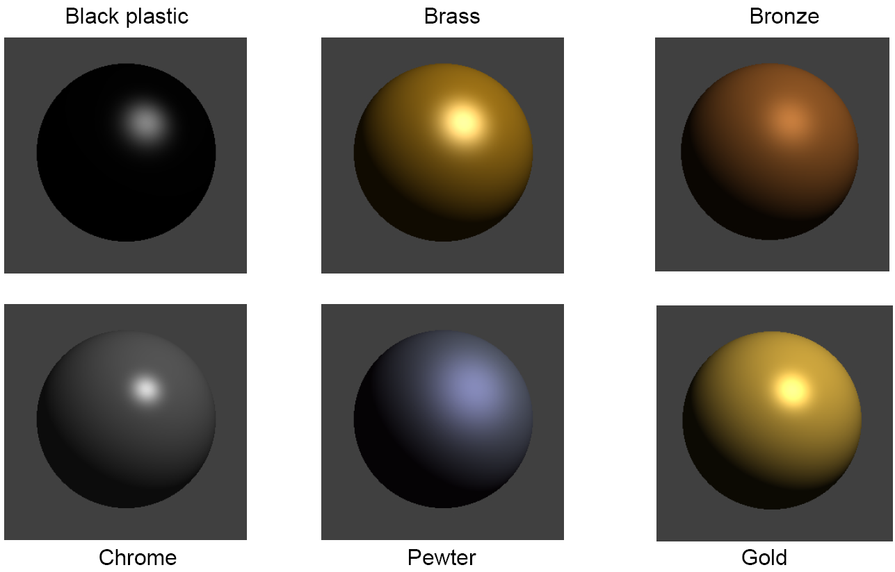
Drawing with Materials
© Hill, 2nd Edition, Fig. 8.17
Material properties are necessary for good looking surfaces, but not enough on their own.
Textures help give objects a more realistic appearance.

Slide 10
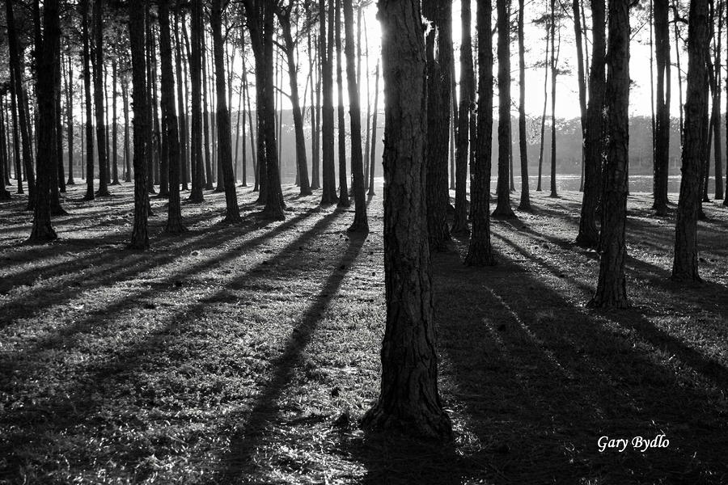
Shadows
So far, we don’t handle the case where objects block light to other surfaces
We need shadows!

Slide 11
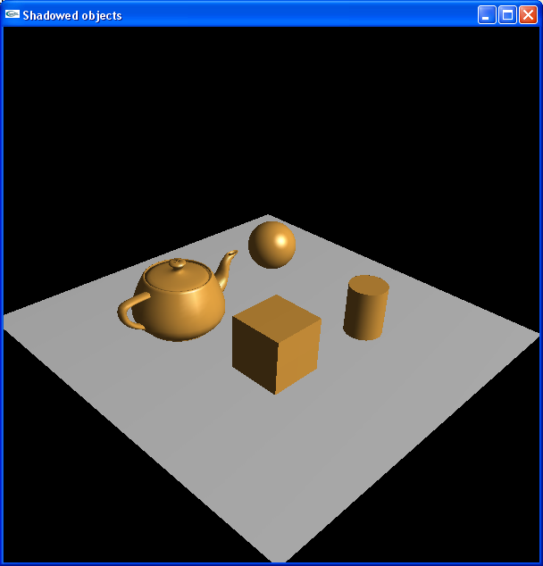
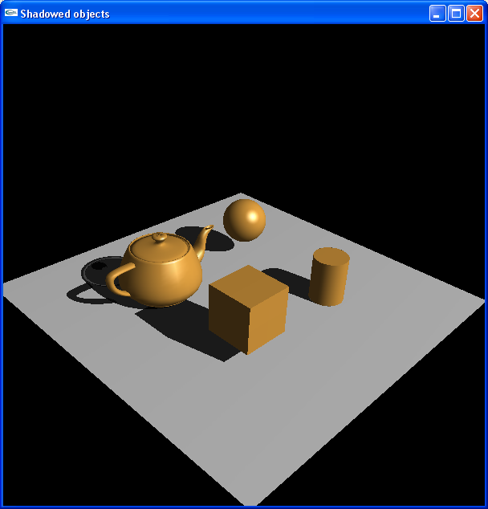
Shadows
Source available on Canvas->Files->OpenGL
No shadows
(can’t see “floating” objects)
Shadows

Slide 12
How to Render Shadows
Where? Points that can be seen but are not illuminated by a particular light source.
How? Many solutions!
Two simple solutions:
Plane projection
Project objects flat on to the surface receiving the shadow
Ray tracing
Trace the path of a light rays (slow but high quality)
Other, less simple solutions
p
p'

Slide 13
Plane Projection Transformations
Assume light source is at origin
Line from light source through p is q(t) = tp
Let plane be ax + by + cz + d = 0
Then at p’ have
Solve for t, calculate q(t) = p’ and get
(0,0,0)
a t p_{x} + b t p_{y} + c t p_{z} + d = 0
p
p'

Slide 14
Plane Projection Transformation
p' = −d p / (a p_{x} + b p_{y} + c p_{z})
Can be written as:
Do division by converting to ordinary coordinates
Applying M_{shadow} to an object yields its planar projection
onto the given plane (assuming center of projection at origin)
(0,0,0)
O
M_{shadow}O

Slide 15
Problems with Projected Shadows
Some of these problems can be fixed, but not all.
What if the ground isn’t flat?
What if we want to project to something other than the ground?
What if shadows overlap?
What if we have multiple light sources?

Slide 16
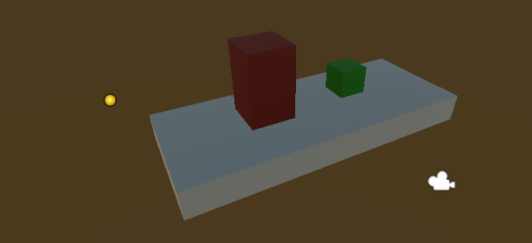
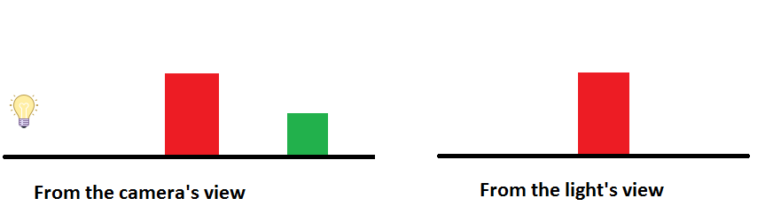
Shadow Maps
If the light was the camera, any part of the scene the “camera” can’t see must be in shadow

Slide 17
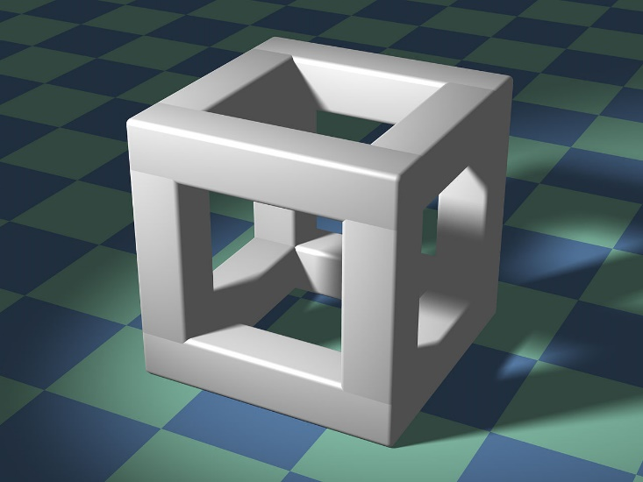
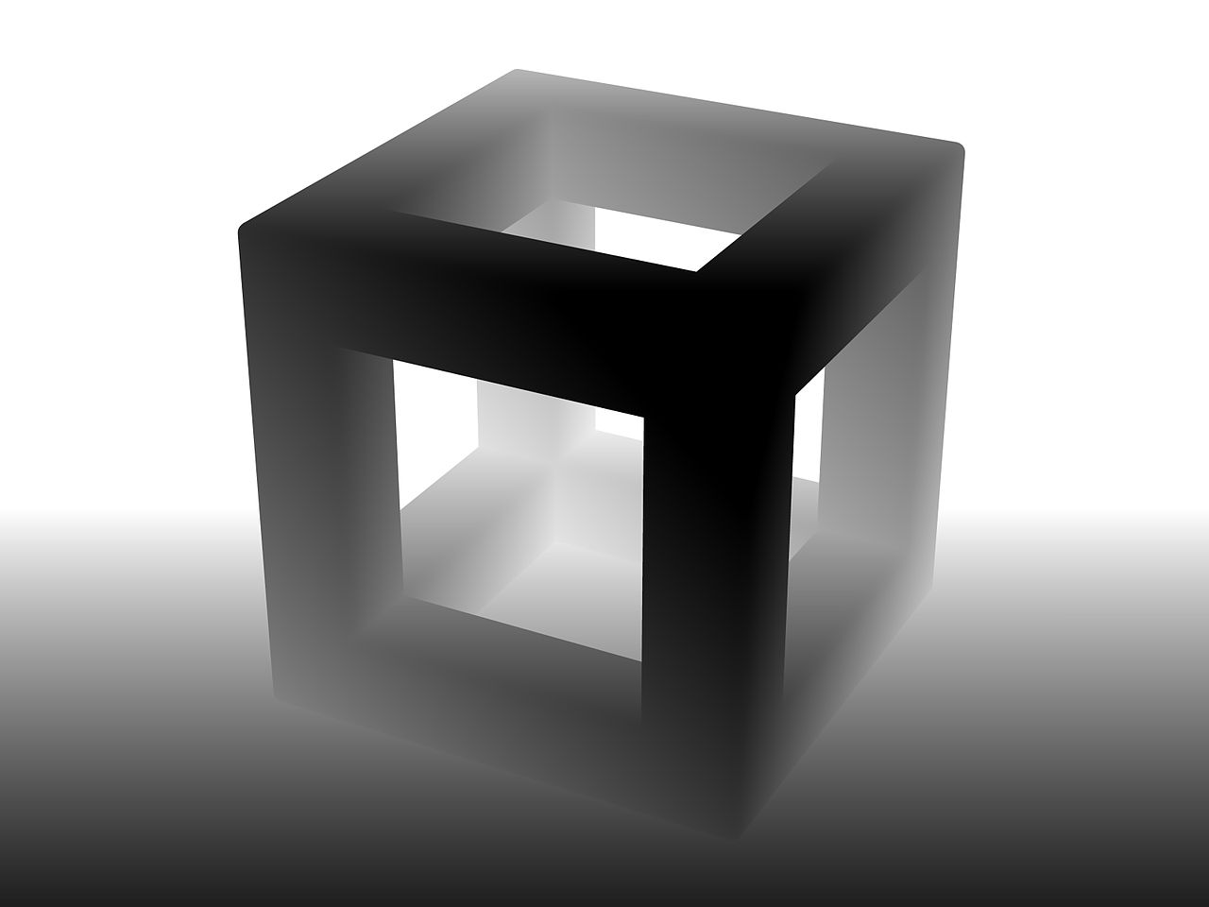
Shadow Maps
When we render, we can save the “depth” into the scene of the pixel
When we finish rendering, we have a map of the closest points in the scene to the “camera” (light)
Dominic Alves
*This image is not rendered from the light’s perspective

Slide 18
Shadow Maps
We draw from the light’s perspective, saving the depths as our shadow map
When we draw it for real, we can:
Figure out which pixel in the shadow map corresponds to the point we are drawing
Check if the point is further away from the light than the depth at that pixel
If so: it’s in shadow!

Slide 19
Shadow Maps

Slide 20
Shadow Map Pros/Cons
Pros:
Cast shadows on any surface
Shadows can handle transparency in objects
Easy to control computation cost
Cons:
We can only draw shadows with hard edges
Shadow detail is limited by the resolution of the depth map
Translucent surfaces cast opaque shadows

Slide 21
Lightmaps
In a scene with many lights and objects that cast shadows, computing light in real-time can be expensive
Better to compute once and re-use

Slide 22
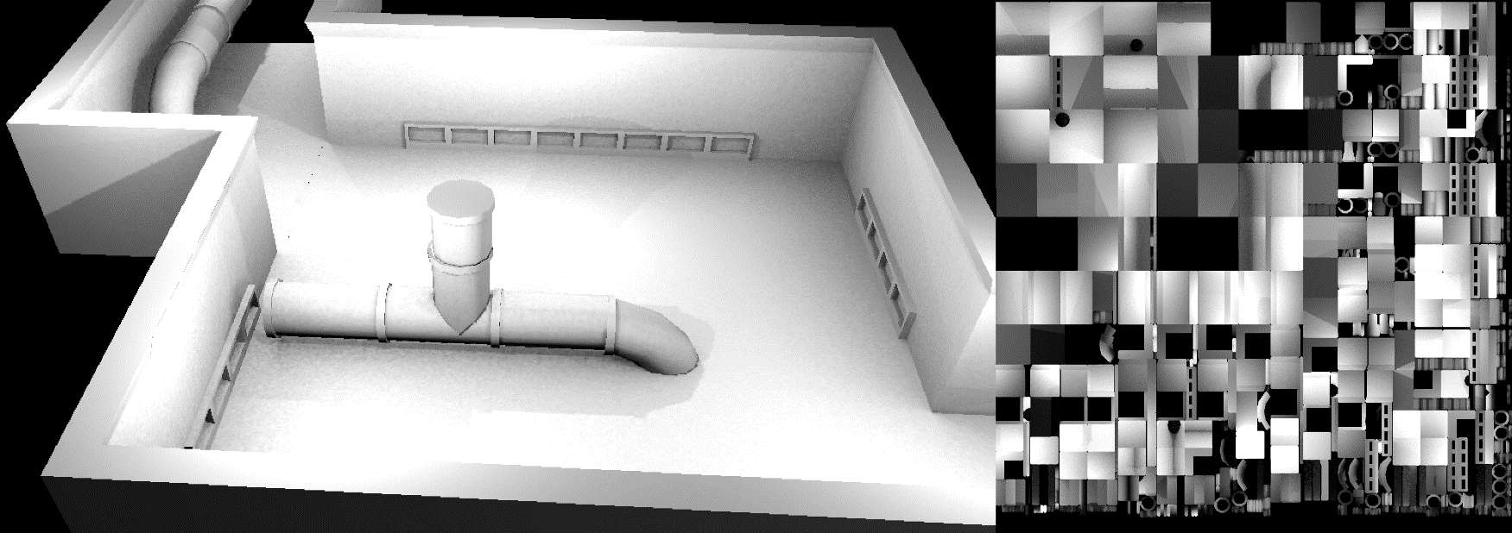
Lightmaps
Compute lighting for each surface of environment
Generate an image from the surfaces of the environment
Save surface lighting in corresponding part of image
Use image values for real-time rendering of scene
Image © Narpas

Slide 23
Lightmap Pros/Cons
Pros
Costs are frontloaded – compute once and re-use
Allows for highly realistic lighting at interactive framerates
Cons
Inflexible
Dynamic environments give odd results
Memory overhead
Compression artefacts

Slide 24
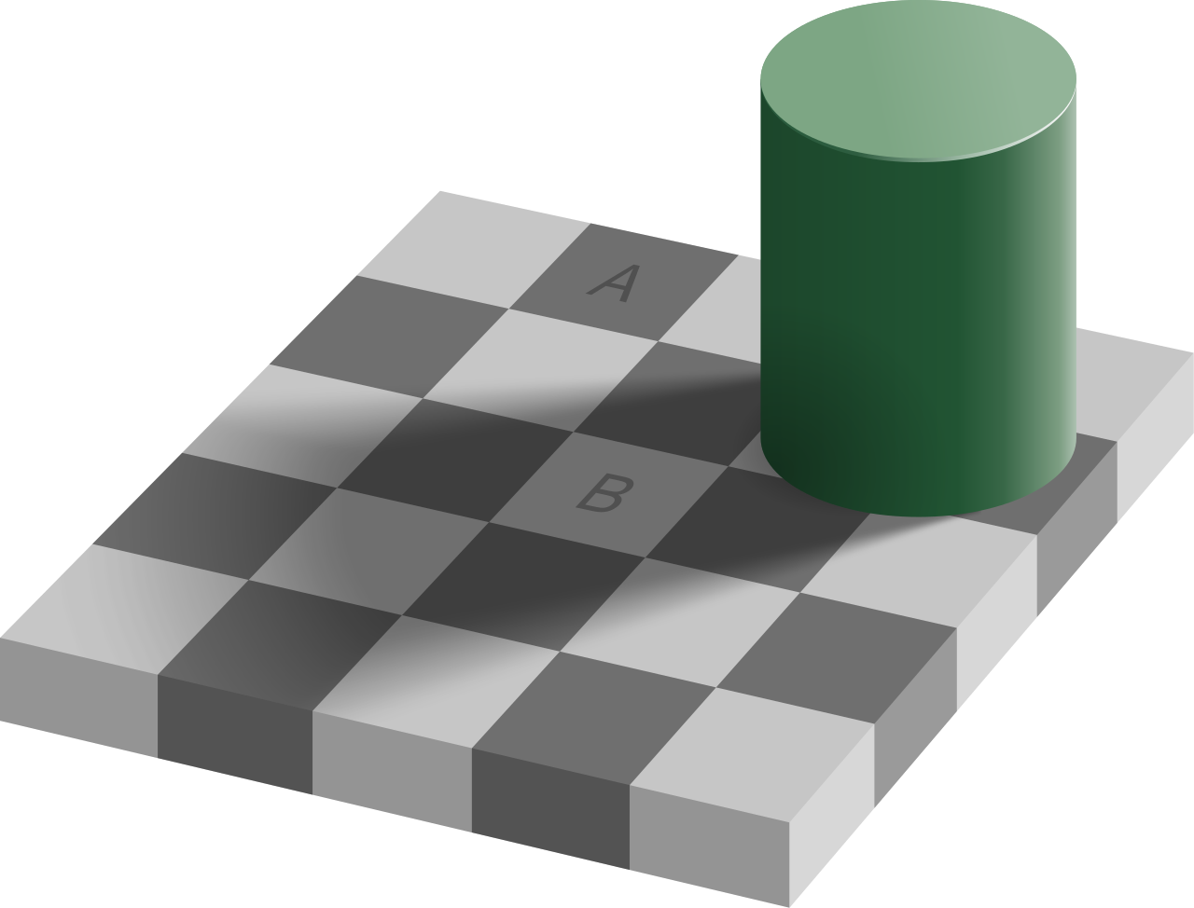
Quiz
The projected shadow implementation assumes the light source is at the origin. How could we handle a light somewhere else?
Edward H. Adelson

Slide 25
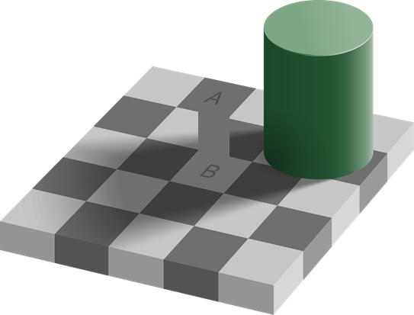
Quiz
The projected shadow implementation assumes the light source is at the origin. How could we handle a light somewhere else?
Edward H. Adelson

